Slide 1

MSE 311: Thermodynamics of Materials
Lecture 6 Heat Engine II
2022 Fall
Weishu Liu
Department of Materials Science and Engineering
Southern University of Science and Technology (SUSTech)
Email: liuws@sustech.edu.cn
Office: North Tower#, Rm310

Slide 2
11. Refrigeration Cycles
Ref. Thermodynamics: A Engineering approach, Chapter 10

Slide 3


Refrigeration and our life
My life is given by the air-conditioning !!!

Slide 4
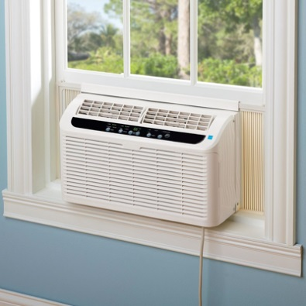
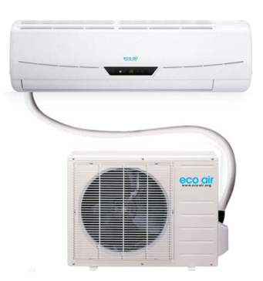
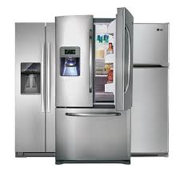
Refrigerator
and air conditioning
History
1834: Jacob Perkins obtained the first patent for a vapor-compression refrigeration system.
1850: Alexander Twining, design and build vapor-compression ice machine.
1890s: refrigeration system began to appear in households
1930s: the vapor-compression refrigeration system become efficient, reliable, small, and inexpensive.
The first refrigerator Made-in China:
1955：天津医疗器械厂试制
1956: “雪花”冰箱
The first air-conditioning Made-in China:
1974：泰州市无线电元件九厂（春兰）， “雪松”窗式空调
1988: 华宝空调器厂, “雪莲”分离式空调

Slide 5

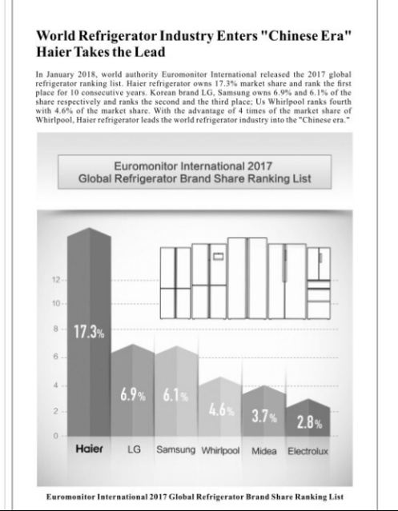
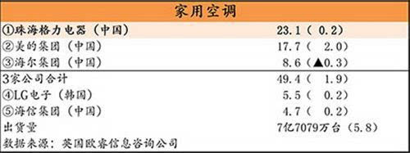

Refrigerator
and air conditioning in China

Slide 6
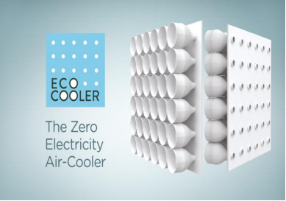
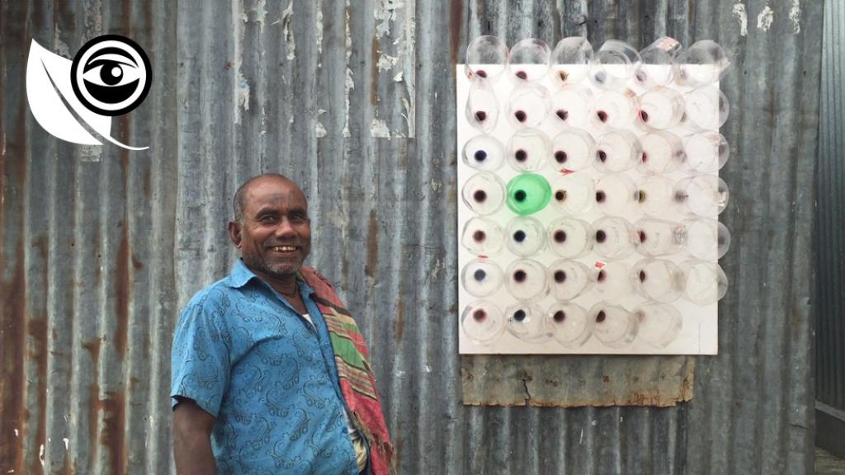
Bangladeshi air cooler
throttling
Adiabatic expansion → internal energy reduced→ reduced temperature

Slide 7
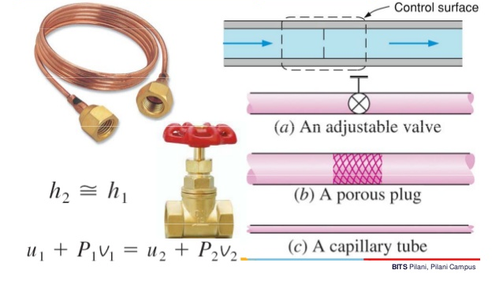
Nozzles and Throttling valve
Energy balance of the steady-flow system
Enthalpy
Internal
energy
Flow
energy

Slide 8
Joule-Thomson effect
The temperature change of a real gas or liquid (as differentiated from an ideal gas) when it is forced through a valve or porous plug while keeping it insulated so that no heat is exchanged with the environment.
μ_{J} >0 temperature decrease after throttling
μ_{J} =0 temperature no-change after throttling
μ_{J} <0 temperature increase after throttling

Slide 9
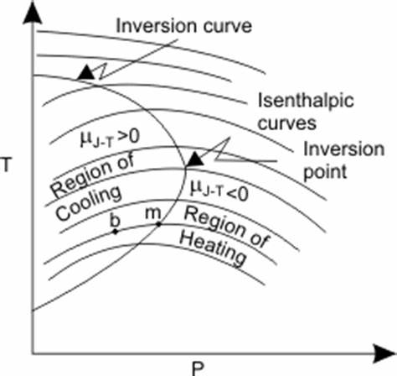
Jouel-Thomson effect
At 25 ºC, if a gas following: PV=RT+6.4x10⁴ P,
Considering a throttling at a pressure of 30MPa, asking the temperature will decrease or increase?

Slide 10
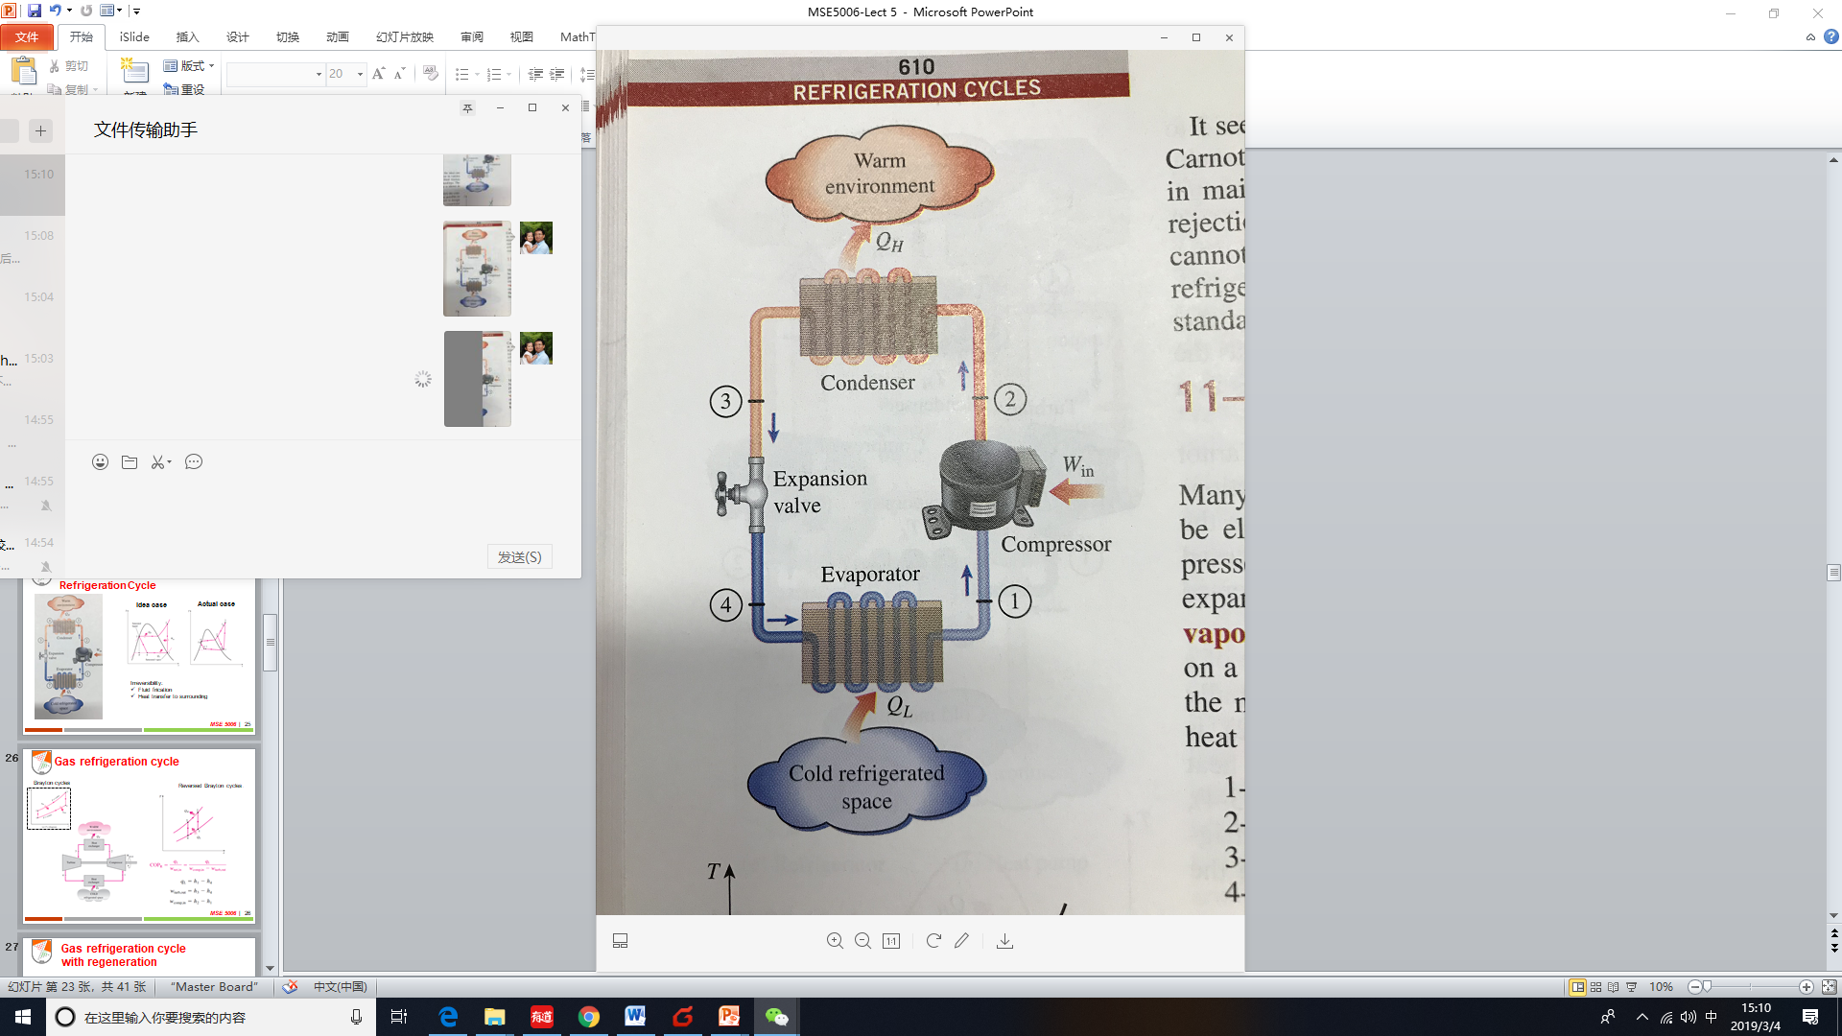
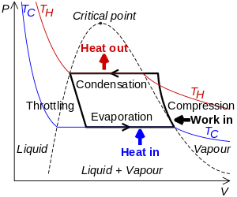
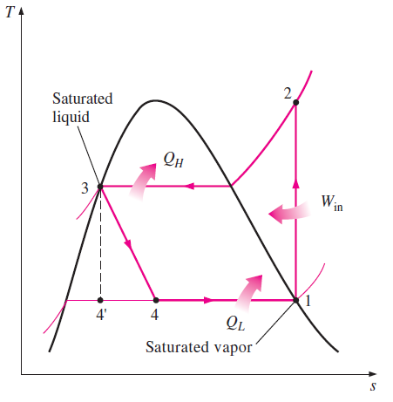
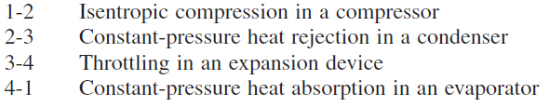
Ideal Vapor-Compression Refrigeration Cycle
3
2
4
1

Slide 11
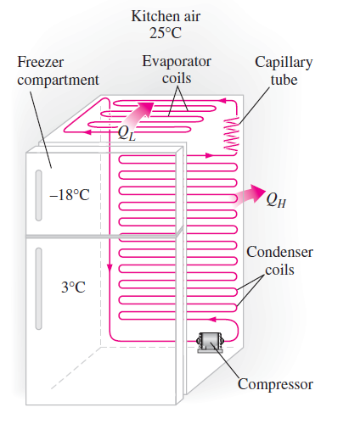
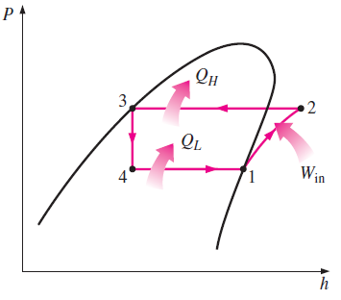


Ideal Vapor-Compression Refrigeration Cycle
Enthalpy, H= U+PV

Slide 12
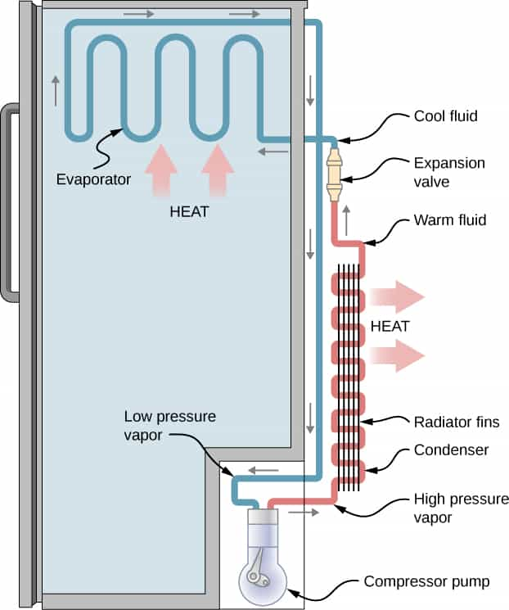

Slide 13
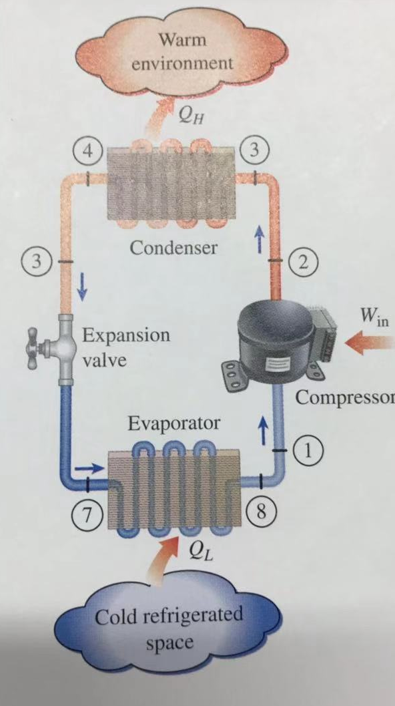
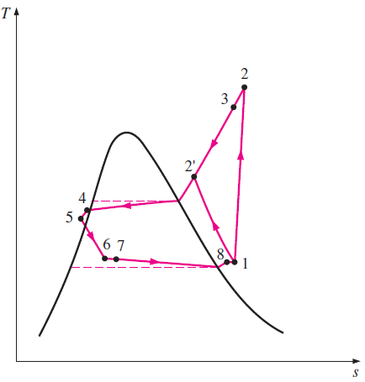
Actual Vapor-Compression Refrigeration Cycle
Idea case
Actual case
5
6
Irreversibility:
Fluid frication
Heat transfer to surrounding

Slide 14
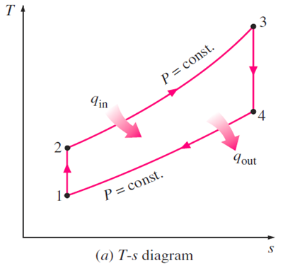
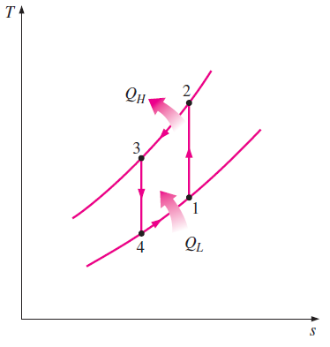
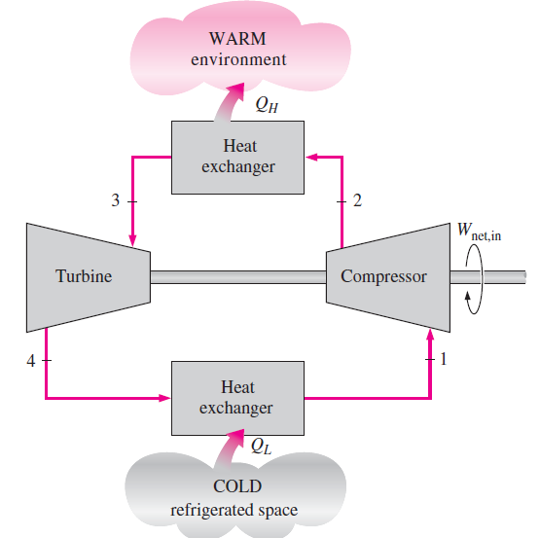

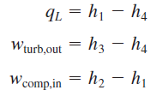
Gas refrigeration cycle
Brayton cycles
Reversed Brayton cycles：

Slide 15
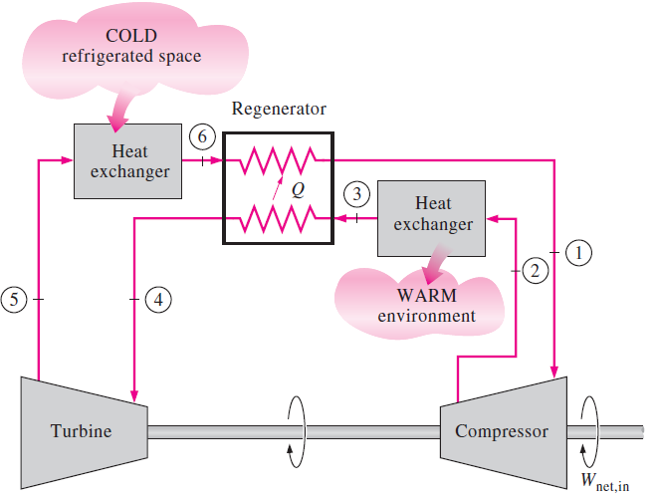
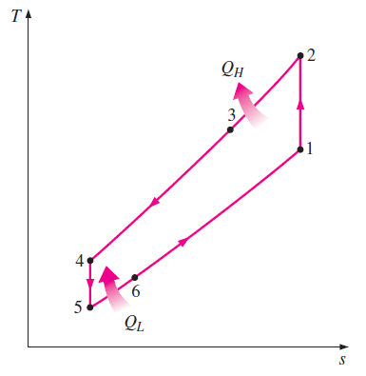
Gas refrigeration cycle with regeneration

Slide 16
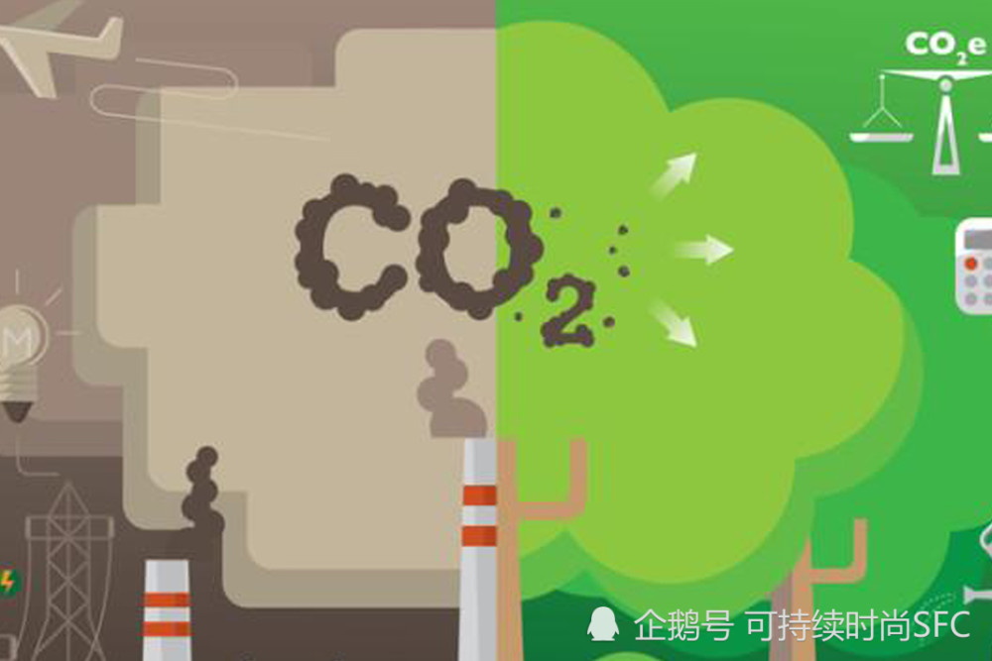

Slide 17
12. Silent power generator and refrigerator

Slide 18
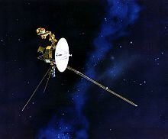
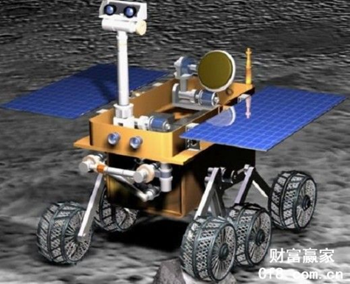
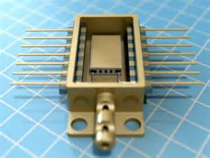
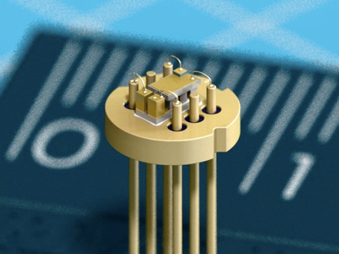
Silent power generator and refrigerator
How to get power in deep space when no enough light available?
How cooling the tiny the laser communicate device quietly?

Slide 19
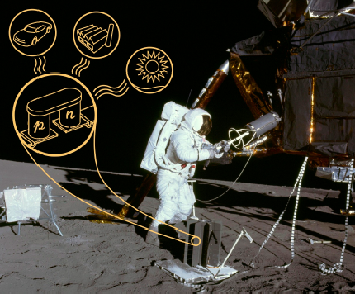
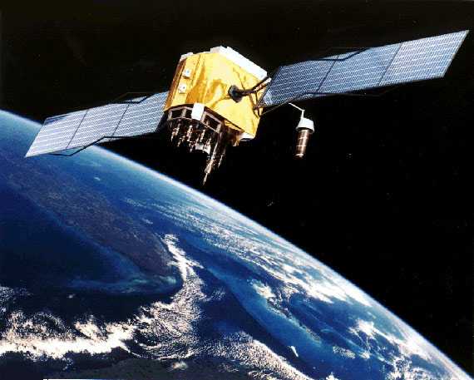
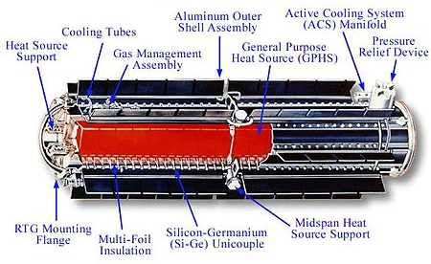
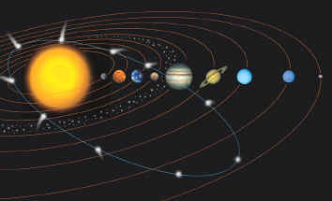
Radioisotope thermoelectric generator
Satellite：Solar cell
Spaceship: RTG

Slide 20
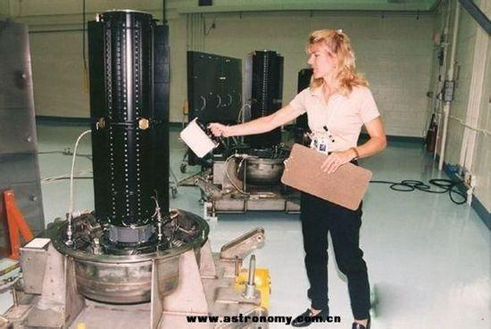
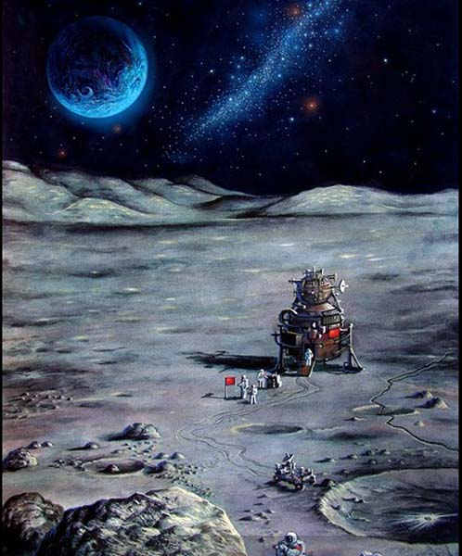
Radioisotope Thermoelectric Generator
RTG made by Ukraine
嫦娥计划

Slide 21




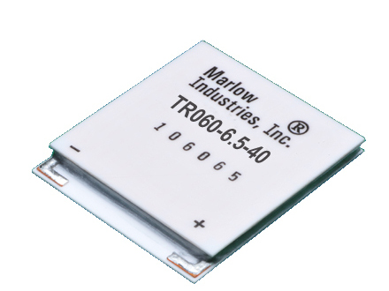
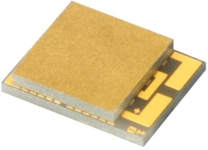
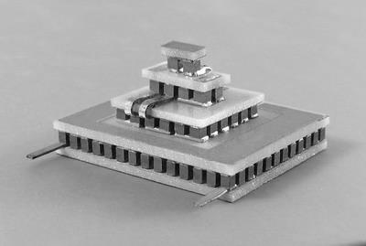
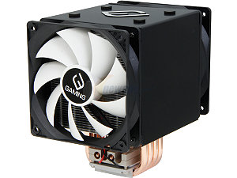
Thermoelectric Cooler (TEC)
Thermoelectric Cooler for CPU
Thermoelectric Cooler for Telecom

Slide 22
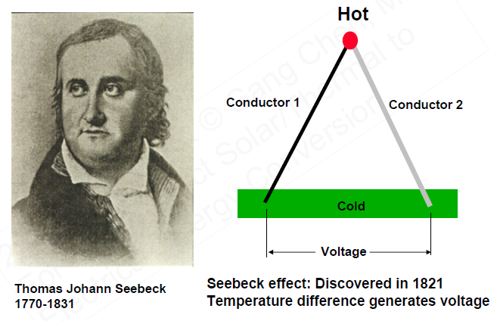
Seebeck Effect
Seebeck Effect, 1821
S, Seebeck coefficient
eg.
Cu: +1.8 μV/K
Bi₂Te₃:+200 μV/K
A
B
Thomas J. Seebeck
German physicist
(1770-1831)
An electrical voltage was produced
by heating the junction between two different electrical conductors (e.g. Cu and Fe)

Slide 23
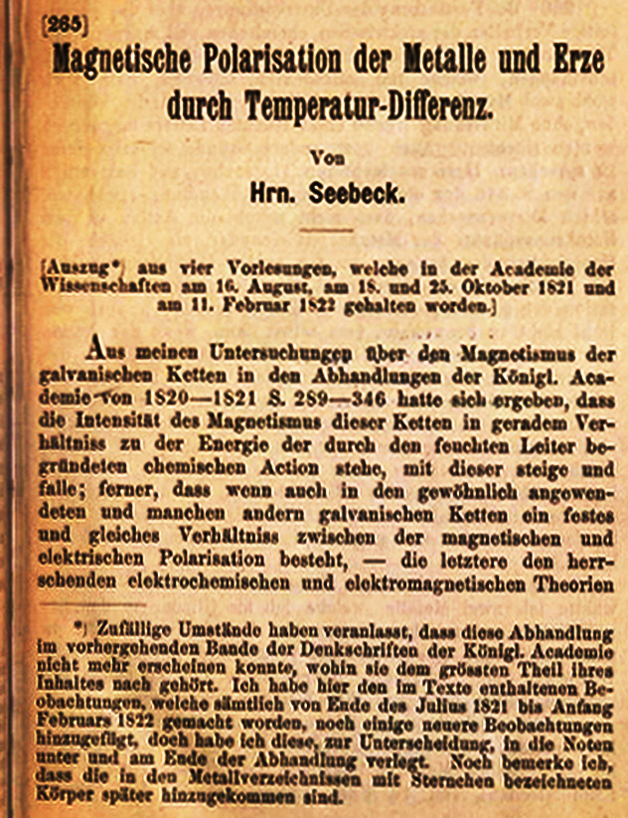
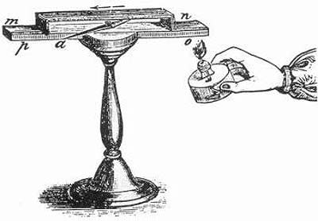
Seebeck Effect
Cu
Current Flow
Bi
Magnetic needle move
ΔV = α ΔT
T.J. Seebeck,
Magnetische Polarisation der Metalle und Erze durch Temperatur-Differenz,
Abh. Deut. Akad. Wissensch. Berlin, Phys., Kl. (J. 1822-1823), p.265-373, 1825

Slide 24
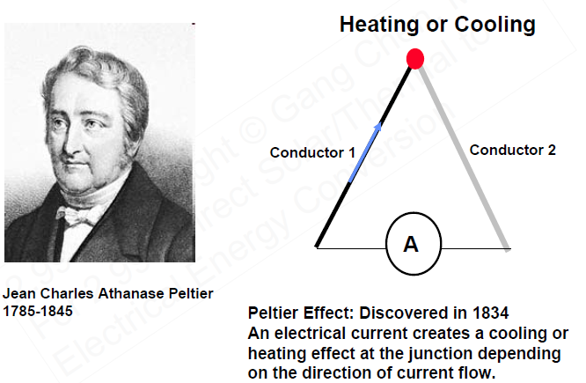
Peltier effect
Peltier effect, 1834
Cooling
Π, Peltier coefficient
N-type
I
P-type
Jean C.A.Peltier
French physicist
and watchmaker
(1775-1845)
Cooling was produced
at the junction of two dissimilar metals as a current pass it

Slide 25
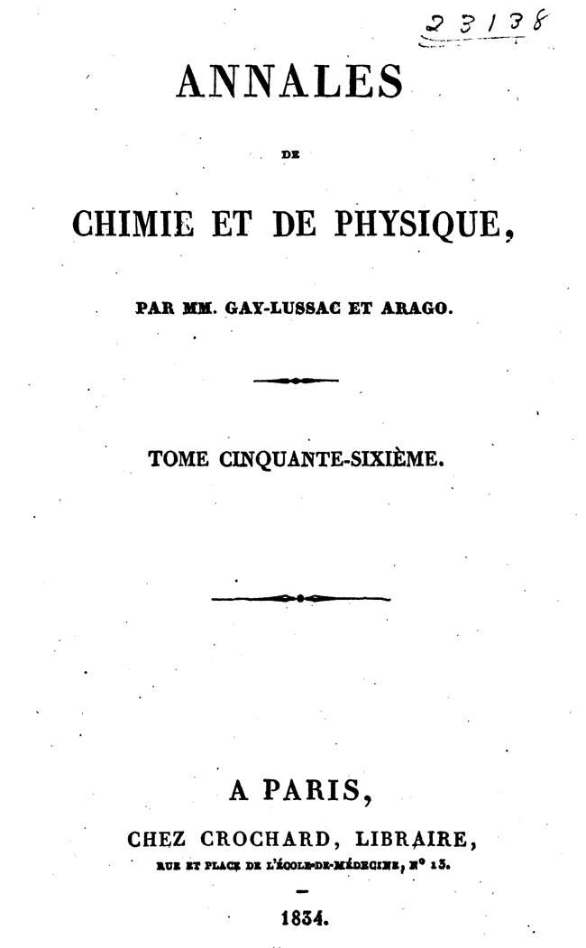
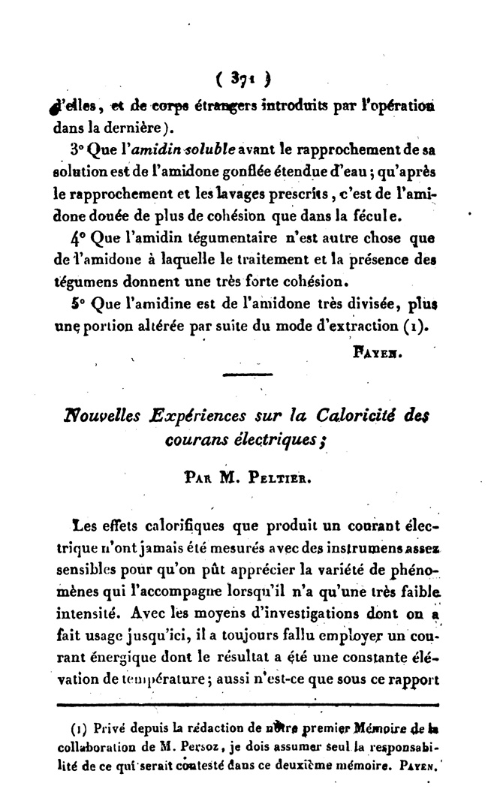
Peltier effect
J.C.A. Peltier, Nouvelles Expériemences sur la Caloricite des courants électriques, Annales de Chimie et de Physique, 56, p.371-386, 1834

Slide 26
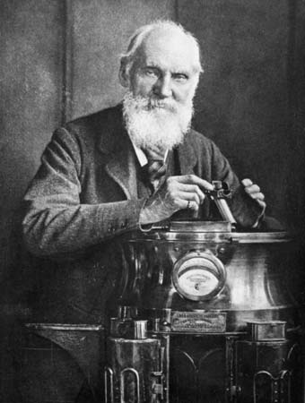
Thomson effect
Thomson effect, 1855
Heat release/absorption, q
β, Thomson coefficient
T_{cold}
T_{hot}
Current, I
Evaluation of heat when electric current passes through a single material that has a temperature difference along its length
William Thomson
1st Baron Kelvin
British physicist
(1824-1907)
Kelvin Relation
英国皇家“开尔文公爵”
* He is widely known for determining the correct value of absolute zero as approximately -273.15 Celsius.

Slide 27
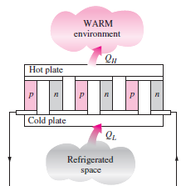
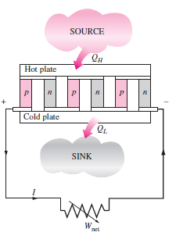
TD of thermoelectric
generator and refrigerator
T_{H}
I
T_{L}
Efficiency of TEG
COP of TEC

Slide 28


Efficiency of TEG
T_{h}
Q_{h}
For simple, Assume:
T-independent S, σ, κ
S_{n} =-S_{p}, ρ _{n} = ρ _{p}, κ _{n} = κ _{p}
leg length =L, section= A
p
n
Q_{c}
T_{c}
I
W_{out}
Efficiency of TEG

Slide 29
Efficiency of TEG
T_{h}
Q_{h}
p
n
Q_{c}
T_{c}
I
W_{net}
Efficiency of TEG

Slide 30
Efficiency of TEG-updated
Efficiency of TEG
Set m=R_{L}/R
Figure of merit
Home work： finishing the derivation of η_{max} for a thermoelectric generator, and thinking about whether the Joule heat term in the Qc could be less than ½ I²R,
if possible how to achieve it, if not why?

Slide 31
Efficiency of TEC
Warm
Environment, Th
Q_{h}
p
n
Q_{c}
Refrigerator
Space, Tc
I
W
COP of TEC

Slide 32
12*. TEG of a real device Considering T –dependent properties

Slide 33
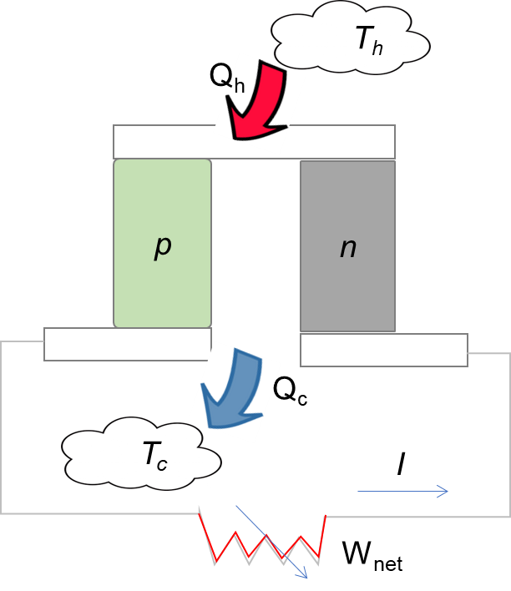
T –dependent thermoelectric properties

Slide 34
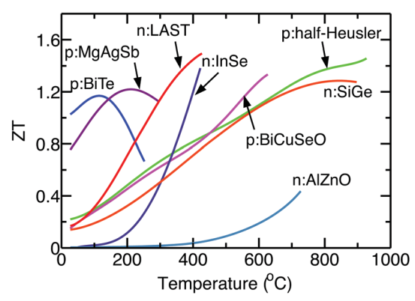









Efficiency of TEG– T dependent properties
What if S, σ, κ are temperature dependent (common case for most materials)?
To answer this question, go back to the governing equation of the thermal-electric transport phenomenon
Current density:
$$\overset{⃑}{J}=σ\overset{⃑}{E}−σS∇T$$
$$\overset{⃑}{q}=ST\overset{⃑}{J}−κ∇T$$
Heat flux:
Continuity equation of charge:
$$∇∙\overset{⃑}{J}=0$$
Energy conservation equation:
$$∇∙\overset{⃑}{q}=\overset{⃑}{J}∙\overset{⃑}{E}$$
$$∇∙\overset{⃑}{q}=\frac{∂}{∂x}\left(−κ\frac{∂T}{∂x}+STJ\right)$$
$$\overset{⃑}{J}∙\overset{⃑}{E}=\overset{⃑}{J}∙\left(\frac{1}{σ}\overset{⃑}{J}+S∇T\right)=\frac{J^{2}}{σ}+SJ\frac{∂T}{∂x}$$
$$\frac{∂}{∂x}\left(−κ\frac{∂T}{∂x}+STJ\right)=\frac{J^{2}}{σ}+SJ\frac{∂T}{∂x}$$
$$\frac{d}{dx}\left(κ\left(T\right)\frac{dT}{dx}\right)+\frac{J^{2}}{σ\left(T\right)}−Jτ\left(T\right)\frac{dT}{dx}=0$$
$$τ=T\frac{dS\left(T\right)}{dT}$$
One dimensional governing equation
H.K. Kim, W. S. Liu, Z.F. Ren, PNAS (2015), EES (2016)

Slide 35








Efficiency of TEG– T independent properties
$$\frac{d}{dx}\left(κ\left(T\right)\frac{dT}{dx}\right)+\frac{J^{2}}{σ\left(T\right)}−Jτ\left(T\right)\frac{dT}{dx}=0$$
$${\left.\frac{dT}{dx}\right|}_{x=0}=\frac{1}{2}\frac{J^{2}}{σκ}L−\frac{∆T}{L}$$
For T independent S, σ, κ
$${\left.\frac{dT}{dx}\right|}_{x=L}=−\frac{1}{2}\frac{J^{2}}{σκ}L−\frac{∆T}{L}$$
$$κ\frac{d^{2}T}{dx^{2}}+\frac{J^{2}}{σ}=0$$
Integrating twice
$$Q_{h}=ST_{h}I−κA{\left.\frac{dT}{dx}\right|}_{x=0}$$
$$=ST_{h}I+K\frac{∆T}{L}−\frac{1}{2}I^{2}R$$
$$T=−\frac{1}{2}\frac{J^{2}}{σκ}x^{2}+C_{1}x+C_{2}$$
x=0, T=T_{h}
x=L, T=T_{c}
$$Q_{c}=ST_{c}I−κA{\left.\frac{dT}{dx}\right|}_{x=L}$$
$$=ST_{c}I+K\frac{∆T}{L}+\frac{1}{2}I^{2}R$$
$$T=−\frac{1}{2}\frac{J^{2}}{σκ}x^{2}+\left(\frac{1}{2}\frac{J^{2}}{σκ}L−\frac{∆T}{L}\right)x+T_{h}$$
Exactly the previously given formula

Slide 36













Efficiency of TEG– T dependent properties
$$\frac{d}{dx}\left(κ\left(T\right)\frac{dT}{dx}\right)+\frac{J^{2}}{σ\left(T\right)}−Jτ\left(T\right)\frac{dT}{dx}=0$$
$$Q_{h}=\frac{A}{L}\int_{T_{c}}^{T_{h}}{\left.κ(T\right)}dT+IT_{h}S(T_{h})−W_{J}I^{2}R−W_{T}I\int_{T_{c}}^{T_{h}}{\left.τ(T\right)}dT$$
For T dependent properties
where
$$R=\frac{1}{ΔT}\frac{L}{A}\int_{T_{c}}^{T_{h}}{\left.ρ(T\right)}dT$$
Integrating once
$$κ(T)\frac{dT}{dx}+J^{2}\int_{0}^{x}{ρ(T)dx}−J\int_{0}^{x}{τ(T)\frac{dT}{dx}dx}+C_{1}=0$$
$$W_{J}=\frac{\int_{0}^{L}{\int_{0}^{x}{ρ(T)dxdx}}}{\frac{L^{2}}{ΔT}\int_{T_{c}}^{T_{h}}{ρ(T)dT}}$$
$$W_{T}=\frac{\int_{0}^{L}{\int_{T}^{T_{h}}{τ(T)dTdx}}}{L\int_{T_{c}}^{T_{h}}{τ(T)dT}}$$
Integrating twice
$$η=\frac{P_{out}}{Q_{h}}=\frac{\frac{V_{oc}^{2}}{R}\frac{m}{{\left(1+m\right)}^{2}}}{\frac{A}{L}\int_{T_{c}}^{T_{h}}{κ(T)dT}+IT_{h}S(T_{h})−W_{J}I^{2}R−W_{T}I\int_{T_{c}}^{T_{h}}{τ(T)dT}}$$
$$\int_{T_{h}}^{T}{κ(T)dT}+J^{2}\int_{0}^{x}{\int_{0}^{x}{\left.ρ(T\right)}dxdx}−J\int_{0}^{x}{\int_{T_{h}}^{T}{τ(T)dTdx}}+C_{1}x+C_{2}=0$$
$$I=\frac{V_{oc}}{R\left(1+m\right)}$$
x=0, T=T_{h}
x=L, T=T_{c}
$$η=\frac{\frac{m}{1+m}}{\frac{1+m}{Z_{eng}ΔT}+\frac{S(T_{h})T_{h}}{\int_{T_{c}}^{T_{h}}{S(T)dT}}−\frac{W_{J}}{\left(1+m\right)}−\frac{W_{T}\int_{T_{c}}^{T_{h}}{τ(T)dT}}{\int_{T_{c}}^{T_{h}}{S(T)dT}}}$$
$$C_{1}=\frac{1}{L}\int_{T_{c}}^{T_{h}}{\left.κ(T\right)}dT−\frac{J^{2}}{L}\int_{0}^{L}{\int_{0}^{x}{ρ(T)dx}dx}+\frac{J}{L}\int_{0}^{L}{\int_{T_{h}}^{T}{τ(T)dTdx}}$$
$$C_{2}=0$$
$${\left(ZT\right)}_{eng}=Z_{eng}ΔT=\frac{{\left(\int_{T_{c}}^{T_{h}}{S\left(T\right)}dT\right)}^{2}}{\int_{T_{c}}^{T_{h}}{ρ\left(T\right)}dT\int_{T_{c}}^{T_{h}}{κ\left(T\right)}dT}ΔT$$
$${\left.−Aκ(T)\frac{dT}{dx}\right|}_{T_{h}}=C_{1}A$$

Slide 37








Efficiency of TEG– T dependent properties
$$η=\frac{\frac{m}{1+m}}{\frac{1+m}{Z_{eng}ΔT}+\frac{S(T_{h})T_{h}}{\int_{T_{c}}^{T_{h}}{S(T)dT}}−\frac{W_{J}}{\left(1+m\right)}−\frac{W_{T}\int_{T_{c}}^{T_{h}}{τ(T)dT}}{\int_{T_{c}}^{T_{h}}{S(T)dT}}}$$
$${\left(ZT\right)}_{eng}=Z_{eng}ΔT=\frac{{\left(\int_{T_{c}}^{T_{h}}{S\left(T\right)}dT\right)}^{2}}{\int_{T_{c}}^{T_{h}}{ρ\left(T\right)}dT\int_{T_{c}}^{T_{h}}{κ\left(T\right)}dT}ΔT$$
$$\frac{dη}{dm}=0$$
$$η_{max}=η_{c}\frac{\sqrt{1+{\left(ZT\right)}_{eng}α_{1}η_{c}^{−1}}−1}{α_{0}\sqrt{1+{\left(ZT\right)}_{eng}α_{1}η_{c}^{−1}}+α_{2}}$$
$$α_{i}=\frac{S\left(T_{h}\right)T_{h}}{\int_{T_{c}}^{T_{h}}{S\left(T\right)}dT}−\frac{\int_{T_{c}}^{T_{h}}{τ\left(T\right)}dT}{\int_{T_{c}}^{T_{h}}{S\left(T\right)}dT}W_{T}η_{c}−iW_{J}η_{c}, i=0,1,2$$
$$m_{opt}^{′}=\sqrt{1+{\left(ZT\right)}_{eng}α_{1}η_{c}^{−1}}$$
${\left(ZT\right)}_{eng}$ is found to be a good index for thermoelectric performance on the device level

Slide 38
12**. TEG of a real system Considering external thermal resistance

Slide 39






Efficiency of TEG– external thermal resistance
What if the boundary temperatures are unknown (common for real applications)?
External thermal resistances (of various levels) exist at the hot and cold sides of the TEG, which contract the effective ${ΔT}^{′}$ from the total $ΔT$ provided by the specific thermal environment
To answer this question, go back to the governing equation with general thermal boundary conditions
$$R_{t,h}=f_{h}R_{t,l}$$
$$\begin{aligned}&\left\{\begin{aligned}&T=−\frac{{0.5I}^{2}RR_{t,l}}{L^{2}}x^{2}+C_{1}x+C_{2} \\ &C_{1}=\frac{1}{L}\frac{{c_{1}f}_{c}I^{2}RR_{t,l}+0.5c_{1}c_{2}I^{2}RR_{t,l}+{αR}_{t,l}I\left(f_{h}T_{c}+f_{c}T_{h}\right)−ΔT}{f_{h}+f_{c}+c_{1}c_{2}} \\ &C_{2}=\frac{1}{c_{1}}\left\{\frac{f_{h}\left[{c_{1}f}_{c}I^{2}RR_{t,l}+0.5c_{1}c_{2}I^{2}RR_{t,l}+{αR}_{t,l}I\left(f_{h}T_{c}+f_{c}T_{h}\right)−ΔT\right]}{f_{h}+f_{c}+c_{1}c_{2}}+T_{h}\right\} \\ &c_{1}={1+f}_{h}{αR}_{t,l}I \\ &c_{2}={1−f}_{c}{αR}_{t,l}I\end{aligned}\right.\#\end{aligned}$$
$$\begin{aligned}&\left\{\begin{aligned}&κ\frac{d^{2}T}{dx^{2}}+\frac{I^{2}ρ}{A^{2}}=0 \\ &−κA\frac{dT}{dx}+αT_{h}^{′}I=\frac{T_{h}−T_{h}^{′}}{R_{t,h}},x=0 \\ &−κA\frac{dT}{dx}+αT_{c}^{′}I=\frac{T_{c}^{′}−T_{c}}{R_{t,c}},x=L\end{aligned}\right.\#\end{aligned}$$
$$R_{t,c}=f_{c}R_{t,l}$$
K Zhu, W. S. Liu, et al., EES (2020)
The Seebeck coefficient is denoted here as $α$ to avoid any confusion with the entropy term (S) which will appear later

Slide 40










Efficiency of TEG– external thermal resistance
Exact solution for the effective temperature difference:
1st simplification
$$T=−\frac{{0.5I}^{2}RR_{t,l}}{L^{2}}x^{2}+C_{1}x+C_{2}$$
$$\left\{\begin{aligned}&T=C_{1}x+C_{2} \\ &C_{1}=\frac{1}{L}\frac{{αR}_{t,l}I\left(f_{h}T_{c}+f_{c}T_{h}\right)−ΔT}{{1+f}_{h}+f_{c}} \\ &C_{2}=\frac{{T_{h}+f}_{h}T_{c}+f_{c}T_{h}}{1+f_{h}+f_{c}}\end{aligned}\right.$$
$$\begin{aligned}&\left\{\begin{aligned}&T_{h}^{′}=C_{2} \\ &T_{c}^{′}=−0.5I^{2}RR_{t,l}+C_{1}L+C_{2} \\ &ΔT^{′}=\frac{ΔT−{αR}_{t,l}I\left(f_{h}T_{c}+f_{c}T_{h}+f_{h}f_{c}I^{2}RR_{t,l}\right)+0.5I^{2}RR_{t,l}\left(f_{h}−f_{c}\right)}{f_{h}+f_{c}+\left({1+f}_{h}{αR}_{t,l}I\right)\left({1−f}_{c}{αR}_{t,l}I\right)}\end{aligned}\right.\#\end{aligned}$$
$$\left\{\begin{aligned}&T_{h}^{′}=C_{2} \\ &T_{c}^{′}=C_{1}L+C_{2} \\ &ΔT^{′}=\frac{ΔT−{αR}_{t,l}I\left(f_{h}T_{c}+f_{c}T_{h}\right)}{{1+f}_{h}+f_{c}}\end{aligned}\right.$$
The closed condition
$$\begin{aligned}&I=\frac{αΔT^{′}}{R\left(1+m\right)}\#\end{aligned}$$
$$\begin{aligned}&b_{0}I^{3}+{b_{1}I}^{2}+b_{2}I+b_{3}=0 \\ &b_{0}=f_{h}f_{c}α^{2}R_{t,l}^{2}Rm \\ &b_{1}={−αR}_{t,l}R\left(f_{h}−f_{c}\right)\left(m+0.5\right) \\ &b_{2}=−\left[α^{2}R_{t,l}\left(f_{h}T_{c}+f_{c}T_{h}\right)+\left(1+f_{h}+f_{c}\right)\left(1+m\right)R\right] \\ &b_{3}=αΔT\end{aligned}$$
$$\begin{aligned}&I=\frac{αΔT^{′}}{R\left(1+m\right)}\#\end{aligned}$$
$$\left\{\begin{aligned}&I=\frac{1}{{1+f}_{h}+f_{c}}\frac{α∆T}{R}\frac{1}{m+1+ZT^{∗}} \\ &T^{∗}=\frac{f_{h}T_{c}+f_{c}T_{h}}{{1+f}_{h}+f_{c}}\end{aligned}\right.$$
Both $I$ and $ΔT^{′}$ are supposed to be solved here
But the cubic equation of $I$ is too complicated
So we need to simplify the temperature profile
Here $I$ is easily solved from a linear equation, thus the derivation could proceed

Slide 41









Efficiency of TEG– external thermal resistance
Approximate solution for the system performance:
$$\left\{\begin{aligned}&I=\frac{1}{{1+f}_{h}+f_{c}}\frac{α∆T}{R}\frac{1}{m+1+ZT^{∗}} \\ &T^{∗}=\frac{f_{h}T_{c}+f_{c}T_{h}}{{1+f}_{h}+f_{c}}\end{aligned}\right.$$
1st simplification
$$ΔT^{′}=\frac{ΔT−{αR}_{t,l}I\left(f_{h}T_{c}+f_{c}T_{h}\right)}{{1+f}_{h}+f_{c}}$$
2nd simplification
$$ΔT^{′}≈\frac{ΔT}{{1+f}_{h}+f_{c}}−\frac{{αR}_{t,l}I\left(f_{h}+f_{c}\right)\left[\overline{T}+\left(f_{h}T_{c}+f_{c}T_{h}\right)\right]}{{\left({1+f}_{h}+f_{c}\right)}^{2}}$$
$$\begin{aligned}&P=I^{2}Rm=\frac{1}{{\left({1+f}_{h}+f_{c}\right)}^{2}}\frac{{\left(α∆T\right)}^{2}}{R}\frac{m}{{\left(m+1+ZT^{∗}\right)}^{2}}\#\end{aligned}$$
$$\begin{aligned}&I=\frac{αΔT^{′}}{R\left(1+m\right)}\#\end{aligned}$$
$$\begin{aligned}&Q_{h}=\frac{1}{{1+f}_{h}+f_{c}}\frac{∆T}{R_{t,l}}\left(1+\frac{1}{{1+f}_{h}+f_{c}}\frac{ZT_{h}}{m+1+ZT^{∗}}\right)\#\end{aligned}$$
$$\begin{aligned}&η=\frac{P}{Q_{h}}=\frac{Z∆Tm}{\left(m+1+ZT^{∗}\right)\left[\left({1+f}_{h}+f_{c}\right)\left(m+1+ZT^{∗}\right)+ZT_{h}\right]}\#\end{aligned}$$
$$\begin{aligned}&P=\frac{1}{{\left(1+f_{h}+f_{c}\right)}^{2}}\frac{{\left(α∆T\right)}^{2}}{R}\frac{m}{{\left[m+1+\frac{f_{h}+f_{c}}{1+f_{h}+f_{c}}Z\left(T^{∗}+{\overline{T}}^{∗}\right)\right]}^{2}}\#\end{aligned}$$
In the previous step, the temperature profile is over-simplified, leading to an error up to 15% for the output power
Here we need to get back some items in the $ΔT^{′}$ term
Now accurate output power estimation (with errors within 4%)

Slide 42








Efficiency of TEG– on three levels
The maximum efficiency and power of a TEG on the system level:
On the material level:
$$\left\{\begin{aligned}&η_{max}=\frac{ΔT}{T_{h}}\frac{m_{opt,η}−1}{m_{opt,η}+\frac{T_{c}}{T_{h}}} \left(a\right) \\ &m_{opt,η}=\sqrt{1+Z\overline{T}} \left(b\right) \\ &P_{max}=\frac{{\left(α∆T\right)}^{2}}{4R} \left(c\right) \\ &m_{opt,P}=1 \left(d\right)\end{aligned}\right.$$
$$\begin{aligned}&\left\{\begin{aligned}&η_{max}=\frac{ΔT}{T_{h}}\frac{m_{opt,η}−1}{m_{opt,η}+\frac{T_{c}}{T_{h}}+β} \left(a\right) \\ &m_{opt,η}=\sqrt{\left(1+ZT^{∗}\right)\left[1+Z\left(T^{∗}+{\overline{T}}^{∗}\right)\right]} \left(b\right) \\ &P_{max}=\frac{1}{{\left(1+f_{h}+f_{c}\right)}^{2}}\frac{{\left(α∆T\right)}^{2}}{4Rm_{opt,P}} \left(c\right) \\ &m_{opt,P}=1+\frac{f_{h}+f_{c}}{1+f_{h}+f_{c}}Z\left(T^{∗}+{\overline{T}}^{∗}\right) \left(d\right)\end{aligned}\right.\#\end{aligned}$$
On the device level:
$$\left\{\begin{aligned}&η_{max}=\frac{ΔT}{T_{h}}\frac{m_{opt,η}−1}{α_{0}m_{opt,η}+α_{2}}\left(a\right) \\ &m_{opt,η}=\sqrt{1+{\left(ZT\right)}_{eng}α_{1}η_{c}^{−1} }\left(b\right) \\ &P_{max}=\frac{{\left(PF\right)}_{eng}ΔT}{4L} \left(c\right) \\ &m_{opt,P}=1 \left(d\right)\end{aligned}\right.$$
$$β=2\frac{T^{∗}}{{\overline{T}}^{∗}}\frac{\overline{T}}{T_{h}}m_{opt,η}\left(1+\frac{m_{opt,η}}{1+ZT^{∗}}\right)$$
$$T^{∗}=\frac{f_{h}T_{c}+f_{c}T_{h}}{1+f_{h}+f_{c}}$$
$${\overline{T}}^{∗}=\frac{\overline{T}}{1+f_{h}+f_{c}}$$
All in the similar form
$${\left(ZT\right)}_{eng}=\frac{{\left(\int_{T_{c}}^{T_{h}}{α\left(T\right)}dT\right)}^{2}}{\int_{T_{c}}^{T_{h}}{ρ\left(T\right)}dT\int_{T_{c}}^{T_{h}}{κ\left(T\right)}dT}ΔT$$
$${\left(PF\right)}_{eng}=\frac{{\left(\int_{T_{c}}^{T_{h}}{\left.α(T\right)}dT\right)}^{2}}{\int_{T_{c}}^{T_{h}}{\left.ρ(T\right)}dT}$$

Slide 43
Open Question
The assumption of ½ I²R is reasonable in real case?

